Slide 1

Historical profiles of modern constitutionalism in Italy
Stefano vinci

Slide 2
Constitutionalism: meaning
The term “constitutionalism” indicates the constitutional doctrine that was the background to the great bourgeois revolutions of the seventeenth and eighteenth centuries
It inspired radical transformation of the political order in Europe and North America, developing, in the modern age, with the affirmation of the sovereign power limits.
According to the prevailing historical reconstruction, the limitation of power would constitute the primary objective of the ideology of constitutionalism, which it has thus developed in the wake of the great currents of political and philosophical thinking of the modern age (individualism, contractarianism natural law).

Slide 3
Differences with the Middle Ages
In the Middle ages the problem of power and its limits was related in political order characterized by the coexistence of
  centers of power with claims to universality, as the Empire and the Papacy
  with particularistic structure of the company
  with the feudal organization
In this frame loom elements of a "medieval constitutionalism"
We find significant traces, for example, in statutes of the municipalities, universities, corporations, as well as in Canon law and constitutions of monastic orders

Slide 4
Medieval Constitutionalism
In these experiences it is possible to detect:
  on the one hand, the tendency to give written form to the constitutional structures of the various components of an ordered and pluralistic society
  on the other hand, the tendency towards differentiation and the articulation of decision-making processes
These are rudimentary mechanisms for regulating the structures of domination, which must be contextualised within stratified and hierarchical societies.

Slide 5
English Experience
The medieval roots of modern constitutionalism has been found mostly in English constitutional history.
Why?
Because in that society it emerges early on a unitary state power and a centralized real justice free from the bonds of universal constraints as the Papacy and the Empire
Already in the thirteenth century jurists of common law initiated a complex processing of the limits of royal power, which used a customary law as opposed to the Roman tradition expressed by the known sentence of Ulpiano «quod principi placet legis habet vigorem»

Slide 6
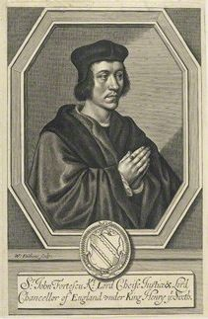
The germs of the representative principle
Thus, for example, it is due to Henry Bracton the formula, taken up later during the constitutional conflict of the seventeenth century, the king is subject not only to God and the laws that make him king, but his Curia, in which the counts and barons are associated with him
They are found here germs of the representative principle and the idea of sovereignty pertaining to King in Parliament,
Although it should be added that the same leges, to which the king was believed subject, were primarily those unwritten, approved by use, ance modifiable with the consensus utentium

Slide 7
The basis of modern constitutionalism
The British did not possess a written constitution
However they have rooted in a centuries-old history of the belief that the limits of political power and the protection of individual rights have had their foundation in the Constitution
When in North America, France and other countries (Poland) made their appearance constitutions and declarations of rights, in England, for over a century, had established:
  a limited monarchy regime
  parliamentary representation on a non-cetual basis
  a formalised legislative process
The foundations of modern constitutionalism had already been laid!

Slide 8
Magna Charta
In fact, some important constitutional documents, one of which dates back to the Middle Ages, constituted a first example of codification of individual rights:
  Magna Charta of 1215
  And others at the height of the struggles against the absolutist conates of British sovereigns, such as the Petition of Rights of 1628.
However, they always had a sphere of effectiveness limited to the aristocracy, the clergy, the cities, and therefore consistent with the particularistic structure of society

Slide 9
1. Federalism on a consociative basis
With the progressive decline of imperial authority, the attempt to regulate political power gave rise to constitutional experiences, of which two aspects deserve to be pointed out:
The first concerns the origins of the "federative principle" in the context of constitutional documents that defined relations of association between small territorial units, based on cities or monarchies, the aims and instruments of a common political organization, and even rules of dynastic succession.
For example: the Rheinischer Bund of 1254 and the Schwäbischer Bund of 1376

Slide 10
1. Orderly agreement between the consociationes
Particular emphasis was placed on the federal principle as a form of association of small republics, as in Switzerland in 1291 and later, with the Union of Utrecht in 1579, which laid the foundations in the Netherlands of the federal order of the United Provinces
Within these experiences matured the theoretical foundation of a federalism on a consociative basis (Althusius).
It aimed at overcoming the opposition between the sovereign and the people, the king and the aristocracy, the Reich and the classes, in order to arrive at a political order that was always unitary, but based on an orderly agreement between the various consociations in which the social body is organized.

Slide 11
2. Genesis of the "principle of representation"
The second aspect concerns the genesis of the "principle of representation"
In this regard we should mention the leges fundamentales that in Germany, in the sixteenth century, regulated relations between the territorial lords and classes (Stände)
In fact, they did not limit themselves to guarantee these rights and privileges, but
  configured the bond with the prince on a basis of a pact (Eg., The Tübinger Vertrag 1514) is
  introduced embryonic forms of representation and participation in collective decisions

Slide 12
social Contract
In the effort to circumscribe, on a pact basis, the power of the sovereign in favour of the classes, one can glimpse pre-constitutional forms of limitation of political power, albeit within the framework of an essentially bilateral conception of the social contract, which did not affect the fullness of the legitimacy of the power of the prince.
Only with the affirmation of individualism and with the seventeenth-eighteenth-century elaborations of contractualism, the paradigm of the social contract will assume an authentically fundamental value of the legitimation of a political order, based not on a different authority than the social body, but on the pact between free individuals.

Slide 13
natural law
The natural law contributed decisively to create the cultural atmosphere in which it would have affirmed the idea that the sovereign is also subject to the law
This idea matured thanks to theories of natural law, understood as prior right to each specific ordering of the political community
The idea of ​​setting up as a higher law represented an additional step, which, however, was rooted in the perception that there were most fundamental laws of other
This constituted an authentic challenge the traditional view according to which Prince was legibus solutus in the exercise of sovereign power

Slide 14
The modern constitutionalism
from the constitutions of the first north american states to the italian charters of rights of the
jacobin period (1797-1799)

Slide 15
Government restricted by law
The idea of a constitution as a higher law is the key to understanding the US constitutional experience and its genesis.
This experience originated, as is well known, from the rebellion of the English colonies against the motherland, and this explains why it was inspired by guidelines that expressed a radical opposition to the English constitutional tradition (republicanism, written constitution, separation of powers and presidential government, federalism).
The idea of the "constitutional government", which was affirmed in the American experience, therefore constituted a resumption of the theme of the government, which was limited by law, even though it was projected on the wide spaces of the federation.

Slide 16
A model for Italy
The North American and French "charters of rights" of the mature Eighteenth century, the first expressions of modern constitutionalism, represented an important point of reference for the constituents of the "Jacobin three-year period" in Italy.
In fact, the "constitutional fever" that broke out in 1776 in the former colonial North American states that declared themselves independent of England and the strong contagion in revolutionary France triggered epidemic influences in many European states.
France had looked with admiration at the American experience, which provided a concrete example of the proper functioning of representative institutions not polluted by the corruption that weighed on Great Britain governed by Sir Robert Walpole and his political heirs.

Slide 17
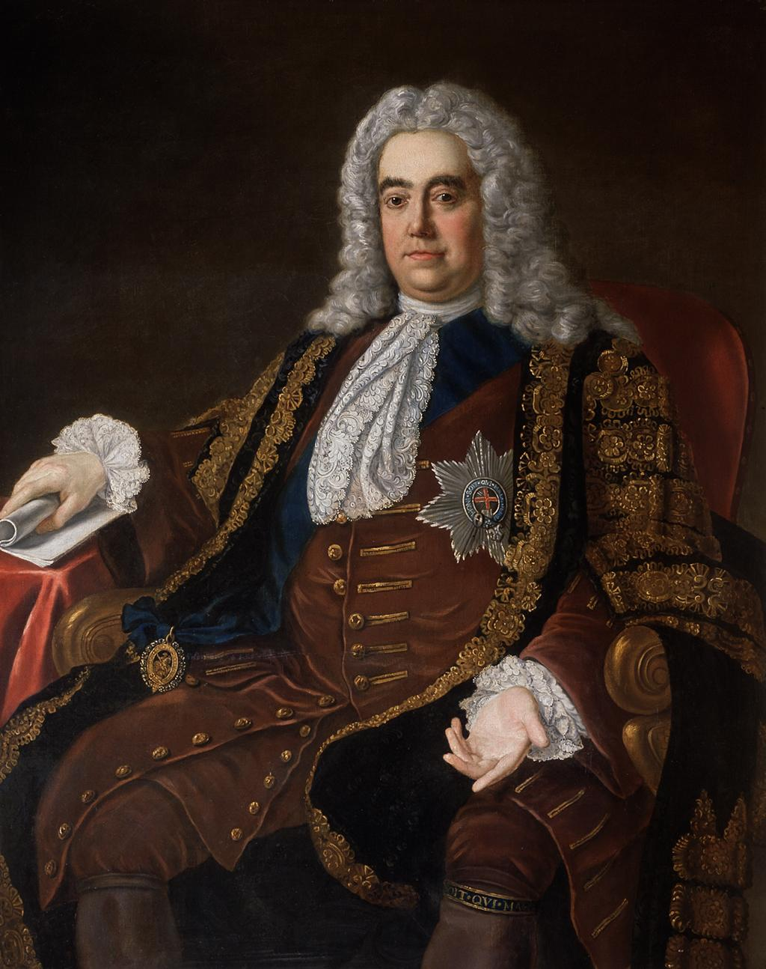
Sir Robert Walpole
Walpole, a member of the Whig party, performed his duties during the reigns of George I and George II.
His ascent is normally dated from 1721, when he obtained the position of First Lord of the Treasury; others fix it from 1730, when - with the withdrawal of Charles Townshend, Viscount Townshend II - he became the only and undisputed leader of the Cabinet.
Walpole continued to rule until his resignation in 1742, making his administration the longest in English history

Slide 18
A look towards America
The French jurists looked at the American "constitutions of government" starting from the Virginia text of 1776, the first legislative act called "constitution" concerning the modes of operation and the fundamental guarantees of a State.
The interest stemmed from the fact that these constitutions
  had regulated the entire system of public authorities
  had provided for a complex set of judicial guarantees for the benefit of the citizens
  had accepted the Enlightenment ideal of equality between men, natural law and the state's contractual theory, the concept of limited government and the principle of popular sovereignty, the right to revolution.

Slide 19
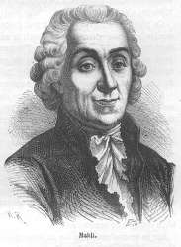
The spread of American constitutions
The American constitutions in their experimental phase lasting about 15 years (1776-1791) were immediately spread across the Atlantic and especially in France
Starting from 1778, these texts
  were published in "Affaires d 'Angleterre et d 'Amérique» with the translation of the Duke Louis-Alexandre de la Rochefoucauld, Secretary of the American ambassador Benjamin Franklin
  were the subject of study, comment and debate in journals such as the Journal encyclopédique of Bouillon, on which also appeared the writings of Abbé de Mably, whose observations on American maps had an impressive echo throughout Europe and especially in Italy.

Slide 20

Boom editorial
Numerous writings were published in France in those years of "editorial boom" pro-American
They included the propangandistic works of Jacques-Pierre Brissot, Filippo Mazzei and Jean-Nicolas Desmeunier, the discouraged comments of Turgot and his pupil Condorcet.
Although they were in favour of the "constitution d'un corps législatif unique", they contested the excessive subordination of US leaders to a polycentric political model such as the English one, with competences shared among a plurality of bodies (chambers, governor, council).
They expressed distrust of the balance of powers mechanism.
Nicolas de Condorcet

Slide 21
Virginia-Pennsylvania-Massachussetts
Among the experimental American constitutions, the most used by the French reforming opinion were those of the constitutional trinomial Virginia-Pennsylvania-Massachussetts "parce que, à l'époque, ces trois états de la Confédération américaine étaient envisagés comme des modèles presque parfaits d'organization des pouvoirs Publics».
Much interest aroused in Europe the Charter of Pennsylvania of 28 September 1776 that, thanks to the popularity of its author Benjamin Franklin, was translated into French in several editions.
Its characters of strong prevalence of the legislative power and unicameralism had incidence in the first phase of the French constitutional debate, in which attention is focused mainly on the problem of separation and balance of powers.

Slide 22
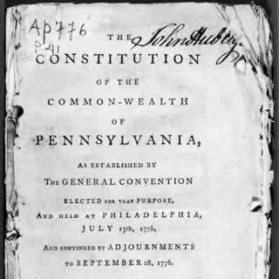
There constitution of Pennsylvania
The constitution of the Pennsylvania was published in France in March 1777 in the Journal Affaires de l'Angleterre et de l'Amerique,
It was republished such as supplement edition of the Science du Bonhomme Richard in same year
In 1778 was published also in the Recueil des Loix Constitutives des Colonies Anglaises
Finally, in 1783 in the Constitutions des Treize États-Unis.

Slide 23
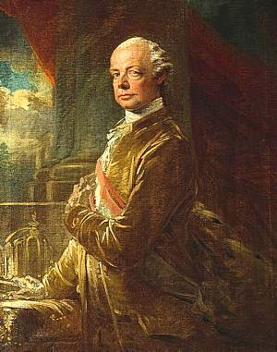
Pietro Leopoldo, Grand Duke of Tuscany
One example is the draft constitution presented on September 6, 1789 which proposed balance du législatif in the form of the royal veto over the acts of the legislature, according to the example set by the constitution of Philadelphia about the presidential veto acts of Congress.
It was also taken as an example for a draft constitution for the Tuscany by Pietro Leopoldo, who made it the subject of detailed Observations.
The Grand Duke focused on regulations governing assembly, which can brake the temptations of his successors to leave the road he paved, without prejudice to its conception of sovereignty and the centrality of the figure of Prince-father of the state.

Slide 24
The good man Richard
The Philadelphia constitutional text was also published in Italian language in a booklet published in Venice in 1797 by the “venetian jacobins” Antonio Marcantoni and Bernardo Maria Calura, containing two writings of Benjamin Franklin: The good man Ricchard and the establishment of Pennsylvania italianized for use of the democratic Venetian restoration.
The preface to the booklet sets out the reasons for the decision to publish this text in preference to the constitutions of other American states:
  1. because the constitution of Pennsylvania was the closest, among the American ones, to the French constitution, as it was based on a single chamber system;
  2. because for most Venetians Pennsylvania, the home of Franklyn, the seat of the General Congress and inhabited by those Quakers who constituted the most widespread American myth of those years, was by far the most famous of the states

Slide 25
Declaration of the rights
The text opened with a Declaration of the rights of the inhabitants of the state of Pennsylvania
It set out the principles of equality between men "born free and independent".
These were attributed "inborn and inalienable rights".
Among the rights attributed there were:
  the enjoyment and defence of life and freedom,
  the acquisition, possession and protection of the property,
  to pursue and achieve happiness and security.

Slide 26
Separation of powers
The constitution adopted the principle of the separation of powers, entrusting the "supreme legislative power" to a chamber composed of representatives of free men.
It provided for particular precautions aimed at avoiding forms of perpetuation in representative mandates.
Assigned executive power to a president and a board (section 3)
Judicial power was entrusted to "courts of justice in the city of Philadelphia and in each of the counties that make up the state" (section 4).

Slide 27
The examination of the people
A particularity of this constitution - which underlined its extremely radical character - consisted in the provision in section 15 of the "examination of the people" for those laws having public object
Before the last reading by the General Assembly, and outside of the case in which speed is indispensable, the legislative proposals would be printed to be submitted to the people for examination and then passed into law at the next session of the Assembly

Slide 28
Council of Censors
The most original part of the Pennsylvania Constitution was represented by the last section which provided for the creation of a political body of the constitutionality of laws (the "Council of censors»)
It was elected directly by the people every seven years,"in order that the freedom of the Commonwealth may well preserved inviolate forever».
This advice (based on the examples of the Spartan ephors and the Roman censors, already called by the writings of Machiavelli, Montesquieu and Rousseau) had "must" of
  examine whether the constitution was preserved in all its parts without the slightest infraction and
  Examine whether the bodies in charge of the legislative and executive powers had fulfilled their functions as guardians of the people

Slide 29
The censors
To this task it is added also to examine whether the public taxes were imposed and rightly perceived in all parts of the republic, what use was made of public funds and if the laws had been well and duly executed.
But what was the powers?
The censors had the power to
  take all necessary papers and records;
  making public censure;
  ordering processes for status offenses
  recommend to the legislative body for the repeal of laws contrary to the constitution;
  convene a Convention in the case of absolute necessity to correct any defective item of the constitution.

Slide 30
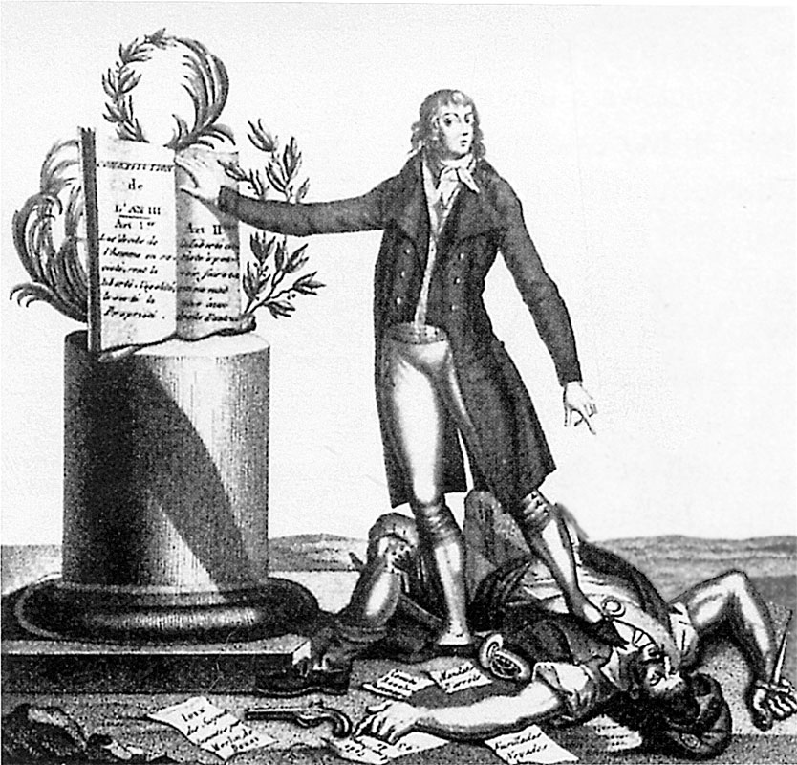
Examples of French constitutionalism (1791-1795)
Queverdo, Francois Maria Isidore
The Tyrant of the Revolution Crushed by the Supporters of the Constitution of An III 25th August 1795
Bibliothèque Nationale, Paris

Slide 31
The spread in France of American examples
The spread in France of texts and translations of the American charters involved the spread of different opinion between
  those who wanted to import in Paris american examples
  those who considered them unsuitable for the French reality, inspired by the theories of Rousseau or by the English model taken as an example by Montesquieu
It was the Girondini exponents, including Brissot and Condorcet, who looked carefully at the American examples used in the drafting of the project for the "Girondina Constitution", presented at the Convention on 15 February 1793.
In fact, since the mid-1980s Brissot and Condorcet have been commenting on American constitutional developments, grasping their new aspects in relation to immediate reforms and in view of the progress of political institutions.

Slide 32
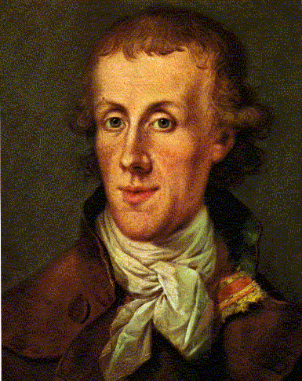
Three categories derived from the US experience
Although distant in their philosophical approach and temperament, their republican thought developed into the progressive acquisition of three major categories developed through reflection on the American experience:
  1) a notion of a constitution based, simultaneously, on human rights and popular consensus;
  2) a specific declination of the distinction between constituent and constituted powers;
  3) a concept of representation characterised by a search for democratic limits to democracy
Jacques Pierre Brissot (1754 - 1793)

Slide 33
The Girondina constitution
he first French Montesquievan-style charter was drawn up by the Constituent Assembly in 1791: its characteristics were still spoiled by a difficult compromise between the monarchy and the bourgeoisie.
The so-called "Girondina constitution" was strongly "Americanising" in that it was designed on the basis of the provision of primary assemblies - which recalled the overseas county assemblies provided for by the constitution of Massachusetts - to which it was conferred:
  the right to legislative initiative
  the right to express oneself by referendum on the laws proposed by the single chamber legislative body
  the possibility of initiating a process of censorship of ordinary laws
  the provision of a mechanism for constitutional revision as an embankment to the threat of deterioration of the constitution by the legislature.

Slide 34
The Montagnard constitution
In addition to these characteristics of representative democracy, there was also the provision for strict control by primary assemblies over legislative power.
In them is evident the reference to the constitution of Philadelphia, which provided for an examination of the people on the laws and a "censorial" control on the constitution
These characters will constitute the most significant differences from the Montagnard project that was developed - the day after the Jacobin coup d'état that marked the exit of the Girondists - by a Comité de Constitution, which saw in Marie-Jean Hérault de Séchelles the main editor.

Slide 35
A never applied constitution
This constitution was approved on 24 June 1793.
It was never applied because of internal difficulties, such as the threat of the federalist revolt and the popular pressure of the Angry and the Sanculots, who did not allow it to govern in compliance with constitutional rules.
It contained regulatory provisions which significantly reduced the role of primary assemblies and which made the right of censure in practice inapplicable.

Slide 36
The constitution of August 22, 1795
The constitution of the 5 fruttidoro of the year III (22 August 1795), was launched after the fall of Robespierre and the dissolution of the Public Health Committee.
It was the most exported and imitated constitutional example of a bourgeois solution for the entire French revolutionary movement from 1789 to the end of the Convention.
In it the Commission des Onze unanimously adopted the bicameral system with the provision of two chambers elected for three years called Conseil des Anciens and Conseil des Cinq cent (inspired by the Senate of the United States of America).
The aim of this system was to prevent a single representative assembly from suffocating the powers of the other constitutional powers, as had already been the case in the past with the Constituent Assembly, the National Legislative Assembly and the Convention.

Slide 37
The ban on the perpetuation of the mandates
To prevent forms of perpetuation in representative mandates, the commission predicted - following the example of the Constitution of Philadelphia - that Deputies could not stand down simultaneously
The 53-55 articles settled, in fact:
  the annual renewal of one third of the members of the two Councils;
  a ban on the candidacy of the outgoing members for a third term until after the legislative period of two years;
  the ban to be members of the legislative body for more than six consecutive years

Slide 38
The organization of executive power
The organisation of the executive power, on the other hand, was widely debated in the Commission, which was divided between those who claimed it should have a monocratic structure - following the example of the President of the American States with the power of veto over the Councils - and those who preferred a collegial solution.
The monocratic idea could not be agreed on because there were too many fears of a return to dictatorship like that of Robespierre and so the collegial solution prevailed in the number of five members who would make up the executive council, which was called the Directory.

Slide 39
The Directory
Unlike the President of the American States, the Directory was not granted the right of veto, but only the possibility of suggesting legislative solutions without participating in the drafting of draft laws.
This meant a weakness in the executive power resulting from a bad separation of powers that had made gears divided - not separated - into two different compartments, without there being any balance.

Slide 40
Attempts to balance of power
It should not be forgotten that, in the fifty days of the constituent debate, attempts were not lacking to achieve a balance between the abuses of legislative power against the executive power.
The proposals were inspired by the institutions provided for in the Constitution of Pennsylvania and were all rejected by the Convention
The first of these was to introduce bodies to control the constitutionality of laws, inspired by the institute of Censorship provided for in the Constitution of Pennsylvania.
A first attempt was made by Jacques-Marie Rouzet, who proposed in February 1793 the creation of a collegiate body, called Eforato, of 85 members, which would have to carry out a prior check on the constitutionality of the laws.

Slide 41
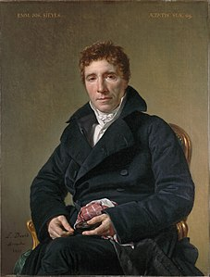
Jury constitutionnaire
Two years later, the abbot Emmanuel Joseph Sieyes proposed the introduction of a jury constitutionnaire
It would have been up to it to pronounce "on the violations and attacks on the Constitution, which will be denounced by the Council of Seniors, the Council of the Five Hundred, the Electoral Assemblies, the Primary Assemblies, the Court of Cassation".

Slide 42
The reasons for the rejection of the project
What were the reasons for the rejection of these projects by the Convention?
The answer to this question is to be found in the conviction of the twelve Commissioners:
  that there was no need for external inspectors of the Constitution who were feared might end up overtaking the others
  but that it was sufficient to provide those who held these powers with guarantees capable of resisting any kind of attack on the powers themselves
In fact, the Council of Censors of Pennsylvania itself was considered ineffective in preventing all violations, to the extent that there was legitimate doubt that preventive action would serve no purpose.

Slide 43
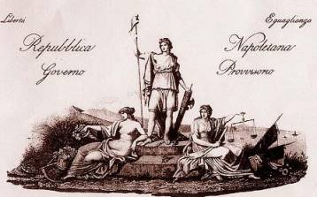
The Italian constitutions of the Jacobin triennium (1796-1799).

Slide 44
The constitutional deadlock
Pietro Leopoldo's constitutional project, inspired by the Pennsylvania Charter, drawn up in 1782 for Tuscany, never came into force, perhaps for fear of renewal.
This demonstrates a constitutional deadlock that also affected the other states that preferred to remain tenaciously attached to traditional institutions.
This "constitutional immobility", which reflected the model of the absolute French state before the revolution, received a strong shock the day after the advance of the Napoleonic army that favored in every Italian state the adoption of a constitution along the lines of the French paper of 1795.

Slide 45
Constitution Projects
Napoleon's entry into Milan unleashed the constitutional ambitions of the Italian Enlightenment, who soon had the opportunity to present their ideas.
The occasion was given by a competition announced on September 27, 1796 by the general administration of Lombardy on the problem Which of the free governments is convenient for the happiness of Italy?
The competition was presented with 57 projects, some of which were also inspired by the American charters of rights
Hence a flourishing, in the various nascent republics, of draft constitutions drawn up following the example of the Thermidorian constitution of the year III

Slide 46
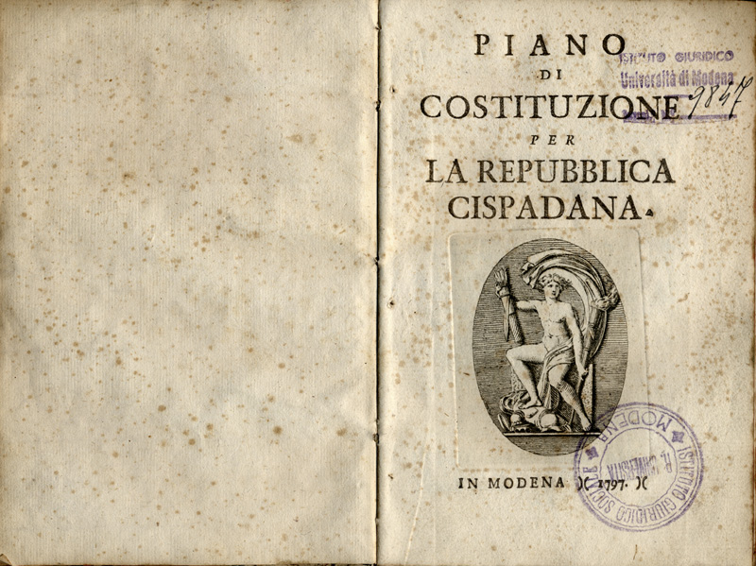
In Bologna, in July 1796, a constitution council worked out a text for the erected Republic, which turned out to have more the appearance of a city constitution than that of a unitary republic.
A few months later, in the framework of the congress of Reggio Emilia, which had proclaimed the Cispadana Republic (erected in the territories of Modena, Ferrara, Reggio and Bologna) one and indivisible, a constitution committee was charged with drawing up a text "fully compliant with the French constitution in all those parts that are compatible with the circumstances of our republic".

Slide 47
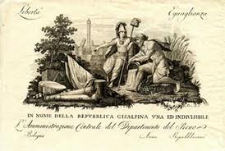
In Milan, Bonaparte gave to the Cisalpine Republic the French text of the year III

Slide 48
the constitutions Jacobin in Italy
In Genoa - where the process of democratization took place without the invasion of the French army - the new provisional government of the Ligurian Republic commissioned a legislative commission to draw up a constitution whose text, subject to changes suggested by Bonaparte himself, which made it very similar to the French constitution of 1795, was approved by the people almost unanimously.
In Rome without a Pope, the proclamation of the Republic was followed by the granting of a constitution drawn up by a French commission which was very similar to the Charter of the Year III.
In 1799, in the small republic of Lucca, there was a brief democratic constitution that can be defined as a synthesis of the example from beyond the Alps.

Slide 49
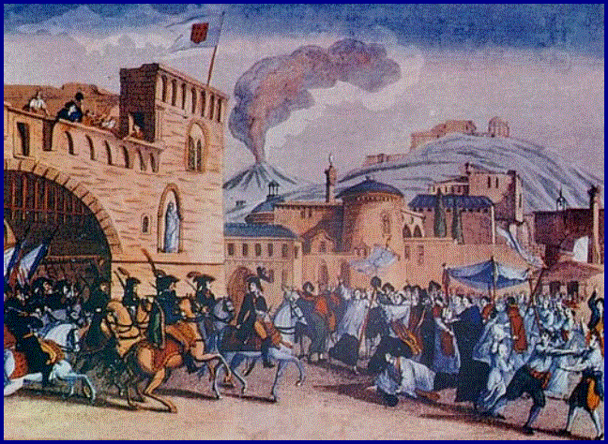
In Naples, the arrival of General Championnet led to the creation of a provisional government within which the Neapolitan Jacobins elaborated the project of a Neapolitan constitution.

Slide 50
The Roman and Neapolitan constitutions
Among these constitutions, the Roman and Neapolitan ones were undoubtedly the most antithetical for at least two reasons:
  for having been elaborated, one by a French commission and the other by a group of Italian Jacobins;
  one strongly anchored to the French Charter of 1795 and the other for its peculiar originality.

Slide 51
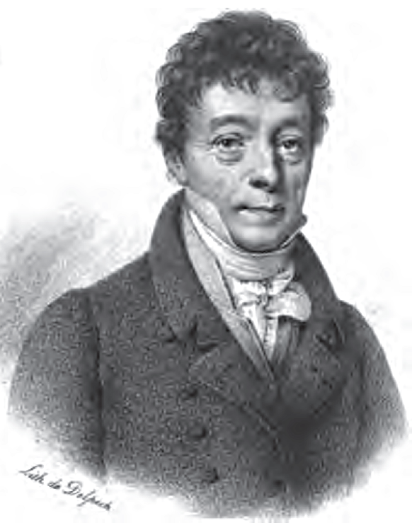
The constitution of the Roman Republic
As for the constitution of the Roman Republic, there was a need to prevent the alliance between the Italian democratic element and the French military exponents (which had already facilitated the rise of Bonaparte).
This led the Directory to entrust French commissioners "civils et politiques", under the direction of Pierre-Claude-François Daunou, with the task of organising and putting into operation a provisional government in Rome and preparing the constitutional text which was presented on 17 March 1798 with a proclamation signed by General Massena, the new military commander.
This Charter, whose authorship was attributed to Merlin De Douai, does not show substantial differences from the French text of the year III except in a variation in the name of the institutes on the basis of a terminology that evoked ancient Rome.

Slide 52
The constitution of the Roman Republic
Preceded by a declaration of the rights and duties of man and citizen similar to those provided by his French sister, the Constitution proclaimed in the first two articles the Roman republic "one and indivisible" and recognized the sovereignty to the universality of citizens.
It incorporated the principle of the separation of powers
It assigned executive power to a Consulate of five members (corresponding to the French Directory).
It assigned legislative power to two separate and independent chambers of two years' duration (corresponding to the Council of the Five Hundred and the Council of the Seniors), which took the name of
  Tribunate, composed of seventy-two members who had the exclusive right to propose laws, and to
  Senate, composed of thirty-two members who approved or rejected the resolutions of the first chamber

Slide 53
Rights and duties
The only variant in the system with respect to the Thermidorian constitution was represented by the provision of the rule of tacit approval in the event of silence or delay by the Senate in the scrutiny of a resolution of the law already voted by the Tribune, if two months had elapsed since the transmission of the proposal and a second invitation to deliberate had intervened.
Rights include freedom, equality, security and property
The Rousseauvian law is affirmed as an expression of the general will "expressed by the majority of citizens or their representatives" (art. 6).
The duties consist in defending, serving, living subject to the law and respecting its organs.
Particular attention is paid to the principle of the intangibility of property, on the maintenance of which "the cultivation of the land, the production, the means of labor and the whole social order rest" (art. 8).

Slide 54
No constitutional control
Following the French example, in this constitution we do not find any body that would remember the Council of Censors of Philadelphia as a guardian of the principles enshrined in the constitution.
Nor did the executive have a veto power similar to that of the United States, which would have affected the legislative initiative of the two chambers.
It is interesting to note that the Consulate, in the same way as the French Directory, had only the power to "invite the tribune or the senate in writing to take an object into consideration: it can propose measures to them, but not projects drafted in the form of laws".

Slide 55
Judicial power
The judicial power was taken away from the legislative councils and the consulate by virtue of the separation of powers
It was entrusted to the courts, whose members were chosen by the electoral assemblies (art. 40).
Compared to the French model, the Roman constitution provided for some corrective measures:
  1. art. 205 of the 1795 constitution on the gratuitousness of justice, which we find in the other contemporary Italian constitutions, was not reproduced
  2. An element of novelty, which is not even found in the laws of the other Italian Jacobin republics, was art. 251, which governed the manner of election of judges of the High Court, with the provision that only married or widowed may be elected members, in order to clearly exclude clerics from these positions.

Slide 56
  The constitution of the Republic Napoletana
The preparation of the project was entrusted to the Committee of Legislation, but was the result of the personal if not exclusive work of Francesco Mario Pagano, president of the legislative committee of the provisional government
He was therefore responsible for the full paternity of the text in which he transferred all the principles that had matured through his Enlightenment cultural formation.

Slide 57
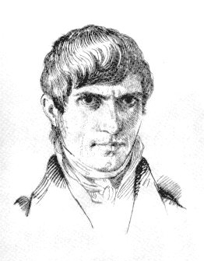
Francesco Mario Pagano
The originality of the project lies in the thought of this eighteenth-century Jacobin "lawyer-philosopher", fascinated by the momentous upheavals that the American and French revolutions had brought about.
In fact, in setting to work hastily completed in just two months that the staggering Neapolitan republic required, Pagano looked at the french constitution of year III and the Constitution of Pennsylvania of 1776 which was one of the most original and striking American examples
He considered it necessary to make territorial changes to the French text, also in view of the crisis in the French management system.

Slide 58
Legislative and Judicial Powers
Based on the French example of 1795, it was preceded by a "Declaration of the Rights and Duties of Man, the Citizen, the People and their Representatives".
The Neapolitan text incorporated the principle of the separation of powers with the provision of a
  Senate of fifty members, widowed or married at least 40 years of age, which was responsible for the legislative initiative on the basis of the belief that "few and mature men can do it better, than burning multitude of young people".
  Council of 120 members at least 30 years of age, who would have approved or rejected bills from the Senate.

Slide 59
Executive power
As for the Directory, the executive power was entrusted to a college of five members, which Pagano called Arcontato
It had the task of promulgating laws, enacting measures for the enforcement of laws and preserving the internal and external security of the Republic
Furthermore, the principle of equality - which was included in the French text as a human right - was placed in first place as the basis for all other rights.

Slide 60
The Ephorate
To guarantee the balance of power, the Neapolitan project provided for the establishment of a body unknown to the French charters, which was given the name of Eforato.
This institution was already identified by the Pagan in his political essays of 1783, as a "balance" that guaranteed the inviolability of the Constitution and put a dam on the overflowing of powers of the Republic.
It recalled the functions of the Council of Censors of the Constitution of Philadelphia.
The introduction of this institution was favored by the believed need to avert the crisis of the institutions that was affecting France
It would have set up a genuine "Constitutional Court ante litteram" as a body external to the legislative and executive powers to ensure their own balance

Slide 61
Custody of the Constitution
The title XIII entitled "Custody of the Constitution" attributed to the seventeen Ephoruses
  the syndicate of constitutionality of laws, to be implemented through the call of each power of government within the respective limits and duties, “annulling the acts of that power that had exercised them beyond the functions assigned to them by the constitution";
  the proposal to the Senate of "revising some of the articles of the constitution, if experience has shown that it is not appropriate";
  the representation to the Legislative Body of the abrogation of "those laws that are opposed to the principles of the constitution“.

Slide 62

Vincenzo Cuoco
Vincenzo Cuoco defined this part as the most beautiful of the Project because it guaranteed a certain stability of the constitution against possible revolutionary drifts

Slide 63
judicial power
Finally, as for France, the judiciary was removed from the executive and legislative powers and administered free of charge by the judges of elective courts.
The project deviated from the Thermidorian model with reference to civil judgments
It provided that appeals should be presented not to the court of another department, as was the case in France with a system "very uncomfortable, and still expensive to litigants", but to a different section of the same court

Slide 64
Criminal justice
As far as criminal justice is concerned, it was entrusted to the "Juries of indictment and judgment", which should also have worked for minor criminal justice
  crimes against the freedom and individual security of citizens;
  against the right of the people;
  resistance to decrees;
  turbulence and violence committed to prevent the perception of contributions;
  the free movement of subsistence, and other commercial objects
This system differed from France, which provided for the intervention of jurors only for the most serious crimes.

Slide 65
Censorship
A distinctive and innovative feature compared to the other Italian and French Jacobin constitutions was represented by the Court of Censorship.
This court, would have the task of preserving and protecting the public Education, constitutionally guaranteed, through the power to judge the customs of the citizens
In particular, art. 305 of the project provided for:
  If someone lives undemocratically, that is, as dissolute and voluptuous, he will give a bad education to his Family, he will use superb and insolent ways, and against equality, he will be deprived of the active right, or passive right of citizenship, according to his guilt. In any case, the penalty may not exceed the three-year period: but for new faults, he may be noticed and punished again.

Slide 66
The education
The focus on physical, moral and intellectual education in the Neapolitan project was a novelty compared to the Thermidorian Charter which only promoted instruction as intellectual training.
The objective of educating man to become a good citizen, deriving from the fear of corruption, which Italian Jacobins feared so much in the face of the not too edifying example given by some French officials and agents of that period
It was answered in concrete terms in title X of Pagano's project entitled "Education, and public instruction", in which public education was distinguished from instruction

Slide 67
Public education and public istruction
The Education was that there should be public places for "gymnastic exercises and warriors", that on public holidays the over seven years should be called "in places established by law to hear the explanation of the Republican Catechism", that should be established "Republican Theaters, in which the representations are directed to promote the spirit of freedom" and "National holidays to excite the republican virtues”;
The Istruction provided, instead, for the promotion of school education, through the institution of "Primary schools, in which young people learn to read, to write, and the elements of Arithmetic, and the Republican Catechism" and "High schools at primary schools, the number of which will be effectively regulated, that there is at least one for each department.

Slide 68
The constitutions of Baiona, Cadiz and Palermo
1808-1812

Slide 69
The Spanish campaign
The five-year period 1808-1813 was very fruitful from a constitutional point of view.
Suddenly, European governments are chasing each other towards the formation of fundamental constitutional texts.
The springboard for this recovery must be found in the turbulent international context and precisely in the Napoleonic campaign of Spain, which the Emperor, in exile in Sant'Elena, judged to be the cause before its ruin.
Until then it had been respected by all
But the conquest of Spain had been a sort of diplomatic "theft" that had precipitated the myth of Napoleon, at least in the eyes of the main European courts.

Slide 70
England's reaction
Napoleon mediated the dispute between the King of Spain Ferdinand VII of Bourbon and his son the Prince of Asturias.
He had called both of them to France and, after having obtained the abdications, apponted his brother Giuseppe Bonaparte king of Spain by the Cortes convened in Baiona, with the help of the troops of the great army "passing through" the Iberian territory.
The anomaly of the conquest forced Napoleon to grant a constitution to the Spaniards, which, for reasons of expediency, was given, with some variation, even to the Neapolitans who, suddenly, had seen their king Joseph Bonaparte leave and waited anxiously to know their future.
Napoleon's "move" determined England's reaction, determined to oppose the Empire by all means, including the constitutional one.
In this context, the constitutions of Cadiz and Palermo were promulgated in an anti-napoleonic key, thanks to the support of England.

Slide 71
It disappears the natural right
The Charts that were promulgated in Spain and Italy between 1808 and 1812 represent, with the French constitution of the year VIII, the first forms of the "statualistic" typology.
With respect to the constitutions of the revolutionary period, the concept of the written constitution remains, as a fundamental norm that regulates the life of the nation, with the attribution of rights and faculties, but the natural right dissolves until it disappears.
With the disappearance of natural law, the dialectic between state and individual is clearly resolved in favour of the first one.
All rights derive from the State.

Slide 72
Citizenship
Therefore, although very different, these constitutions have an important common element:
  Man is no longer the subject, but the person and precisely the citizen to whom the rights enshrined in the constitution are connected.
The declaration of human rights disappears and all rights are linked to the state of citizenship, regulated by rules placed significantly at the head of the constitutions.
It is true that it is acquired by birth in the national territory but, unlike the quality of Man, it can be lost, definitively or temporarily.
Thus, the institution of citizenship takes on considerable importance

Slide 73
French Constitution of the Year VIII: artt. 4-5
Art. 4. The status of French citizen is lost:
  By naturalization in a foreign country;
  By acceptance of functions or pensions offered by a foreign government;
  By affiliation to any foreign corporation which would imply distinctions at birth;
  By conviction to afflictive or infamous penalties.
Art. 5. The exercise of the rights of a French citizen is suspended:
  by the status of bankrupt debtor, or immediate inheritor, holder free of charge of the total or partial inheritance of a bankrupt;
  by the status of hired servant, attached to the service of the person or the household;
  by the status of judicial prohibition, accusation or in absentia

Slide 74
The constitution to legitimize the existing power
The loss of citizenship leads to the loss of ownership of rights and freedoms: it is the State that creates the rights by attributing them only to citizens.
The constitution of the year VIII was the first to take this path and for this reason it can be considered a sort of prototype.
But it was also important because it characterized the Napoleonic regime as constitutional.
Napoleon always wanted to present himself as a constitutional monarch and his regime as a constitutional regime.
His concept of constitution was, however, particular and very distant from that developed in the revolutionary assemblies: the constitution served to legitimize an already existing power, conquered and maintained by force of arms.
The constitution assumed a function instrumental to the interests of the Emperor and the Empire, both in internal and in foreign politics.

Slide 75
Popular Sovereignty
In Spain the constitution of Baiona served to legitimize the power of Joseph Bonaparte
In Naples, the constitution of Baiona served to arm the reforms of the two-year period 1806-1808 against possible reforms that the new king Murat could have launched.
Why recourse to the constitution, when legitimacy came from force?
The idea of a constitution as the foundation of all power, born during the revolution, had already entered the consciences of Europeans thanks to the Napoleonic campaigns.
The people had entered the political scene overwhelmingly, had become aware of its strength and, above all, had adopted the equation: people = nation = sovereignty.
The people felt to be the holder of sovereignty.

Slide 76
People and nation
For this reason, Napoleon wanted to put the constitution of the year VIII and its coronation to the French emperor for a referendum.
The people - between the end of the eighteenth century and the beginning of the nineteenth century - came to coincide with the middle class, that is, with the bourgeoisie that won the French Revolution.
The bourgeoisie was made up of the owners and professionals who, endowed with heritage, participated in the life of the state.
The others, the landless, the homeless, the unemployed, were excluded: for them were ready repressive means of exceptional justice (without guarantees, according to ad modum belli procedures).
The vastness of the brigandan phenomenon in the nineteenth century represents well the objective exclusion from the law and society of large sections of the population.
People and nations are the binomial around which the constitutional history of the nineteenth century revolves.

Slide 77
Nationalism
The universalistic vocation of the Enlightenment, admirably expressed by Kant in his works and founded on the values of natural law doctrine, gives way to nationalism which, from a cultural point of view, finds a solid point of reference in historical doctrines.
The history of the nation becomes the basis on which to build its constitution, its legal system.
All the counter-revolutionary current draws from it with full hands, from Edmund Burke to Joseph-Marie de Maistre.
In Germany, first Johann Gottlieb Fichte, then Friedrich Carl von Savigny exalt the history of the German people
In Italy, Vincenzo Cuoco has a historicist basis for his intense criticism of the 1799 republic and the constitutional project of Mario Pagano, accused of abstractionism.

Slide 78
Baiona, Cadiz and Palermo
The constitutions of Baiona, Cadiz and Palermo are part of this framework, which - always in a state context - constituted as many models:
  Baiona for the "administrative monarchy",
  Cadiz for the democratic state
  Palermo for the liberal state.
Among these model-constitutions, the greatest success was the Chart of Cadiz, which, for its very advanced content on the democratic level, was the reference point, especially for the Carboneria.
But also Baiona and Palermo played a role in the constitutional debate of the European nineteenth century, contributing decisively to the birth and consolidation of a national and constitutional conscience of the Spanish and Neapolitans.

Slide 79
Pact with the Iberian people
The Spanish constitution given to Baiona also arose from the need to establish a pact with the Iberian people:
  On the one hand the Spaniards recognized Joseph Bonaparte as a new monarch.
  On the other hand, Napoleon granted them a constitution with some important guarantees, including the obligation of Spanish citizenship to hold any public office.
It was also necessary to have a regular composition and functioning of the Parliament.
Finally, there were the dynastic issues that needed a statute.
Only through a charter that fixed these points at least, Napoleon could have hoped to bring to a successful end the unscrupulous and difficult campaign of Spain, because it was difficult for the Iberians to accept the submission to France.

Slide 80
The costitution of Baiona for the Neapolitans
In Baiona Giuseppe Bonaparte convinced Napoleon to grant the constitution he was preparing for Spain to the Neapolitans.
The reasons that convinced the Emperor to take this step can be summarized as follows:
  1) The Neapolitans, already suddenly abandoned by their monarch Giuseppe Bonaparte, would have taken very badly the fact that he granted a constitution only to his new subjects. The discontent could have generated problems of public order that in that phase it was better to avoid.
  2) Joseph Bonaparte wanted the reforms he passed in 1806-1808 to form the legislative basis of the new kingdom of Naples. The constitution would have armoured them against any hypothetical reform.
  3) Joachim Murat, Napoleon's brother-in-law, would have arrived in Naples as the new king: the constitution would have served to call him to order in the event that he were not in line with imperial politics.

Slide 81
Naples and the English
However, Naples was not Spain.
There were no Cortes, there was no very pronounced national spirit and there was not even a bourgeoisie to rely on.
Like Spain, however, it represented a military front against the Anglo-Bourbons.
If Spain had not yet been fully conquered, the Kingdom of Naples felt the "breath on its neck" of the English fleet stationed off Sicily.
And since in Napoleon's choices the military motivation must always be considered prevailing, it must be considered that this similarity determined the Emperor to grant the Neapolitans the constitution of Baiona prepared for the Spanish, except for a few variations (in Naples was not established the Senate).

Slide 82
Characters of the Constitution of Baiona
It was a granted constitution (ottriata), born in particular circumstances: the text was approved by a council formed by 65 Spanish deputies and then approved by the Cortes.
Historiography does not recognize particular merits to this constitution - granted by an intruder Rey - except the fact that it was the first fundamental act of Spain.
There is no rule indicating where sovereignty resides, which must be considered entirely in the hands of the monarch, according to the scheme of the absolute state of the ancient regime.
There is no trace of inviolable rights of a naturalistic law matrix, there is no mention of the division of powers: only a vague reference to the independence of the judiciary is made: "El orden judicial será independiente en sus funciones".
The courts are at the king's service, since he alone is responsible for summoning them.
They have a general advisory role in tax matters and in amending the codes.

Slide 83
Political Representation
The centrality of the Council of State and of the ministers - responsible for the execution of laws - characterizes this constitution as bureaucratic or administrative.
Then there is the anachronistic rejection of political representation and the return to cetual representation.
As is well known, one of the greatest innovations of the revolution was the passage from the cetual representation (the parliaments of the ancient regime were structured in classes and voted according to class) to the political representation, based on the concept of equality.
Political representation meant that the choice of the representative was made on the basis of the ideas and opinions of which he was the bearer and not on the interests of the class to which he belonged.

Slide 84
Nobles, Clergy and People
Napoleonic constitutionalism, despite the whole revolutionary process that had led to this conquest, instead provided for a cetual representation in the parliamentary assemblies.
The constitution of Baiona in particular provided that the Cortes were made up of three states, Nobles, Clergy and People.
The totalitarian regime wanted by Napoleon Bonaparte could not tolerate opinions and therefore it was more functional to admit a representation of interests
Therefore it can be said that in Spain, as in Naples, the real parliament was represented by the Council of State, which, formed by the most prominent men in the country, knew how to better represent the people and, in some cases, was able to interpret the national feeling.

Slide 85
Freedom
Few rights and freedoms are granted by this constitution.
Habeas corpus is solemnly proclaimed, as is the principle of legality in criminal matters and the abolition of torture.
However, in the face of this, no rule is in place to guarantee the freedom of expression of thought.
With regard to freedom of worship, the Catholic religion is proclaimed state religion and the exercise of other cults is expressly prohibited.
Nothing is available even in matters of the press, since a discipline on the matter is referred to a specific law to be approved in the future.
However, the constitution establishes a Senate, composed of twenty-five members appointed for life by the Sovereign to «velar sobre la conservación de la libertad individual y de la libertad de la imprenta».

Slide 86
Deployment Spanish political
The historical merit of this constitution consists mainly in having pushed the English to oppose the Napoleonic regime on the constitutional front, preparing for Spain and the Kingdom of Naples the most advanced constitutions.
Moreover, after the enactment of the constitution of Baiona - considered negatively in general - the political line-up of the Spanish people began to emerge, divided between
  conservatives, in favour of a return of Ferdinand VII and the absolute regime (right)
  liberals, dissatisfied with the constitution of Baiona and determined to call for a truly liberal constitution (left)
  jovellanos, in favour of reforms but against revolutionary extremism (centre).
Beside and above these factions there was the Spanish Church, whose action will be decisive in the development of events, also from the constitutional point of view.

Slide 87
The Constitution of Cadiz
In 1810, the Supreme Central Council - the central body of the Spanish resistance to France - gathered in Cadiz the Cortes, initially to form a legitimate government to oppose that of Giuseppe Bonaparte.
This decisive event was possible thanks to an agreement between the Church and the liberals, determined to face the French invaders together.
In the assembly were placed 90 clergymen, 56 jurists, 14 nobles, 15 professors, 49 senior officials, 8 traders, 20 without a defined profession.

Slide 88
Costitutional Assembly
Against the ancient composition of the Cortes, many bourgeoisie were part of it, also because of the impossibility for many nobles to reach Cadiz.
Following the English victories on Spanish soil, the hypothesis of a return of the legitimate sovereign began to take shape in concrete terms
Thus the Cortes became a Constitutional Assembly and work began on the preparation of a constitutional text.
The new constitution was promulgated on March 19, 1812 a few months before the taking of Madrid and the return to the capital of Ferdinand VII (August 6, 1812).

Slide 89
The Cortes and the constitution
The constitution of Cadiz has been variously considered and defined: democratic, republican, liberal, jurisdictional, legal.
Among those of the Napoleonic era, it is without doubt the chart closest to the constitutions of the revolutionary period, for some contents that can be linked to natural law doctrine and the Enlightenment.
It could be elaborated and promulgated thanks to the particular political conditions in the country: the French arrogance had performed the miracle of uniting in a single feeling divergent and opposing forces such as the liberals and the Church, with the blessing of England (which had understood the strategic importance of the war in Spain) and Ferdinand VII (eager to regain his throne).
Unlike the constitution of Baiona, it was a constitution that came from below, because it was wanted and approved by the Cortes and signed by all the deputies.

Slide 90
Democratic Character
The initial articles are significant of the tendentially democratic character of Cadice's constitution:
Art. 1. The Spanish Nation is the meeting of all Spaniards of both hemispheres.
Art. 2 The Spanish Nation is free and independent, and is not and cannot be the property of any family or person.
Art. 3. Sovereignty resides essentially in the Nation, and therefore it belongs exclusively to the Nation the right to establish its fundamental laws.
Art. 4. The Nation is obliged to conserve and protect by wise and just laws the civil liberty, property and other legitimate rights of all the individuals that compose it.

Slide 91
Legislative power
The declaration that sovereignty resides in the nation is missing, as we have seen, from the constitution of Baiona and is also missing from the constitution of Palermo.
The nation is therefore the only one to hold and exercise legislative power, which, according to Article 4, must be directed to protect the civil liberties, property and legitimate rights of all individuals who compose it.
This article refers to the two main natural rights indicated by natural law, namely freedom and property.
There is an important reference to the legitimate rights of all individuals who make up the Spanish nation, which it is obliged to protect with wise and fair laws.
It is a very vague formulation, with reference both to the guardian and the object of the protection, and to the recipients of the same.

Slide 92
Separation of powers
In the constitution of Cadiz we are also a clear separation of powers:
  Art. 15. The power to make laws resides in the Courts with the King.
  Art. 16. The power to enforce laws resides in the King.
  Art. 17. The power to apply the laws in civil and criminal cases resides in the courts established by law.
The deputies of the Cortes would be elected through a mechanism of three electoral sessions: the parish rallies elected the district electors, the district electors, gathered in the district rallies, elected the provincial electors and the latter, gathered in the provincial rallies elected deputies and alternates.
The cetual system established by the constitution of Baiona was repudiated and all Spanish citizens were admitted to vote.

Slide 93
The Cortes
The legislative initiative to which all Members are entitled without distinction
The king was responsible for the sanction of the laws: he could deny it, within a maximum of thirty days with a written explanation of the reasons, but he had to surrender before the third presentation of the same project according to the procedures established by the constitution.
The set of rules dedicated to them shows that the Cortes represent the centre of the political life of the nation.
The exhaustive list of the king's faculties, within the executive power, is aimed at protecting the Cortes from any abuse of the crown.
The Cortes also proposed to the king the names of the State Councillors. Which made this body, so strong in the constitution of Baiona, completely in the hands of the Cortes

Slide 94
Justice and process
With regard to the administration of justice, the independence of judges is solemnly proclaimed, guaranteed by provisions that protect judges from arbitrary acts of dismissal or transfer.
Similarly, the responsibility of the judge is established who, in case of abuse, is subject to popular action.
A Supreme Court of Justice is introduced, to which the highest judicial functions are attributed.
Particular attention is given to criminal justice. Under Article 287: "No Spanish citizen may be imprisoned without prior summary information of the fact (…)".
The advertising of the process was then guaranteed and all forms of torture were banned.
However, the discipline of the concrete aspects of the trial (accusatory or inquisitorial, separation of de facto and de jure judgments, juries, etc.) was postponed to subsequent laws.

Slide 95
A model for the nineteenth century
From what has been said we can understand how the constitution of Cadiz represented a model for democrats and liberals of the nineteenth century.
It placed Parliament at the centre of political life and limited the functions of the monarch.
It was a model not only in Europe but also in South America.

Slide 96
The Constitution of Palermo
1812

Slide 97
A constitution "strange"
Historiography recognises the importance of the Palermo constitution of 1812 in the history of Sicily and the Italian Risorgimento.
In fact, the constitution, wanted by the English, written for the island's barons on a generic British model, supported Sicily's aspirations for independence from the Kingdom of Naples and reflected fairly faithfully its secular social and institutional structure.
It was a constitution written in a sometimes confused, repetitive, redundant way.
It is also difficult to find the rules that interest and quote them, since the articles are not numbered consecutively.

Slide 98
A constitution “conventional" and liberal
It was a constitution
  not imposed (by the King, as the constitution of Cadiz)
  not granted (by the Emperor as the constitution of Baiona)
  but founded on a pact between the dominant forces (English, barons and in the background the Church)
  with a decisive role for the Crown that expressed on each article proposed by the Parliament the Placet or the Vetat
  and, like all difficult "contracts", it is complicated and non-linear
This conventional character is certainly one of the aspects that justifies the attribute of liberal with which the constitution of Palermo is traditionally connoted.
By the term “liberal” we mean a constitution based on the separation of powers and a substantial limitation of the monarch's powers

Slide 99
An aristocratic constitution
The constitution of Palermo aimed to preserve the ancient and vast privileges to the protagonists of the coup d'état, ie the Sicilian barons.
Therefore it can be defined as a liberal constitution, which, in this case, does not mean a bourgeois constitution: the constitution of Palermo can in fact be called an aristocratic constitution.
Taking advantage of the weakness of the Bourbon crown and the protection of England, the barons succeeded in imposing themselves on King Ferdinand.
The aristocracy, who identified with the Sicilian nation, accused the king of having created obstacles to the economic development of the island and of having mortified its ancient independence.
These claims were strongly supported by the British government's desire to achieve total military rule in Sicily and to counter Napoleonic constitutionalism with a charter more liberal than that of Baiona.

Slide 100
An important step
The Sicilian constitution of 1812:
  it is one of the greatest events in European history that preceded and prepared for the fall of Napoleon
  is one of the great juridical-institutional and economic-social transformations of the South Italy that created the conditions of the unitary national process, concluded in 1860 with the end of the reign of the Two Sicilies

Slide 101
The English constitutional model
The clashes between barons and crowns, which exploded with the convening of parliament in 1810, reached their peak with the arrest of five leaders of the aristocratic party.
The decisive factor was the appointment as plenipotentiary of the Sicilian government of Lord Bentink, weighty exponent of the Wigh Party, who after verifying the immobility of the Bourbons, obtained extensive powers from his government.
The King was removed from Palermo, the prince Francesco was appointed vicar general, and the Parliament was charged with preparing a constitution on the English model.
Blackstone's work on the English constitution was a guide for the drafting of the Constitution of Palermo
In the end, the text deviated greatly from the English constitution

Slide 102
The heart of the constitution
The constitution opens with a preamble of XII heads that indicates the guidelines, the bases, elaborated directly by the leaders of the baronial party (Balsamo, Castelnuovo and Belmonte), accepted by the Bentinck and imposed on the Vicar (with the Royal sanction).
These are articles formulated in a very clear way that guided the Palamento in the elaboration of the complete text and that concerned:
  The Catholic religion as state religion.
  The attribution of legislative power to Parliament
  The attribution of executive power to the King
  The independence of the judiciary from the executive power
  Assertion of the principle of legality
  Abolition of fiefdoms and cessation of baronial jurisdiction

Slide 103
Contents
These basic items are developed in the long constitution, drawn, not without conflict, by Parliament.
On some points the constitution is very detailed:
We find real laws on the abolition of feudalism, on press freedom - guaranteed in principle but subject to many limitations - the trusts (Fideicommissum) and judicial order.
Unlike the Constitution of Cadiz, the king's power to put the placet or vetat to the law appears unlimited, so as to configure, in fact, against the provisions of article 2 of the preamble, a share of the monarch to the legislative branch.

Slide 104
The citizen participation in the legislative power
The proposal to make every citizen participate directly or indirectly in the legislative power, was expressly rejected by the monarch, as is clear from Chapter VIII of the title Freedom, rights and duties of citizens:
The Parliament, made up of an Peers' Chamber and a Commons' Chamber, held "the power to make laws, and to dispense, interpret, modify and repeal them".
The King could convene and dissolve the Parliament at will, subject to the obligation to convene it at least once a year.

Slide 105
House of Peers and Communities
The Chamber of Peers was made up of barons and clergymen who currently "have a right to sit and vote in Parliament".
The Peers would have been entitled to one vote each, regardless of the plurality of titles and lands they owned
The House of Commons was made up of representatives elected mainly from the 23 districts into which the island was divided (two representatives from each district).
However, any city or land with more than 6000 inhabitants would have appointed its own representative.
The representatives would be elected by citizens with a net annuity of at least 18 ounces for each year.
Members of Parliament enjoyed immunity in respect of activities carried out in the performance of their duties

Slide 106
From feudal ownership
The rights expressly guaranteed included habeas corpus, the principle of legality in criminal matters and protection against abuse of judicial power and executive power.
The most significant aspect of this constitution is the transition from feudalism to the property regime.
Feudality was abolished, but all feudal possessions were transformed sic et simpliciter into allodial properties.
It was an important victory for the Sicilian aristocratic party, which finally translated into (constitutional) law an aspiration that had always been opposed by the Bourbons.

Slide 107
Rights of commons
With feudalism all ancient Rights of commons were abolished (to the advantage of the feudal lords)
The general rule was abolition without compensation, unless civic custom was recognised in a written deed of property or in a contract or judgment.
This means that, in order to be liquidated, the uses would necessarily have had to be in writing.
It was a very heavy condition for the municipalities, since the rights of commons were based mostly on ancient customs
It was a disposition to the full advantage of the barons, divergent from the discipline arranged in the kingdom of Naples with the subversive laws of Feudality
These laws gave municipalities the right to bring actions against barons for the recognition of civic customs regardless of the existence of written acts declaring their existence.

Slide 108
Exclusive advantage of the former barons
Also interesting is the constitutional norm that established the inalienability of ecclesiastical goods
This rule suggests an agreement between the landed aristocracy and the Church to the detriment of the bourgeoisie
Overall, the transition from feudalism was carried out for the exclusive benefit of the former feudal lords, and thus to the detriment of the peasant populations, stripped of their rights over the former feudal lands, as well as the local bourgeoisie, deprived of the land market of ecclesiastical goods.

Slide 109
An opposite pattern
The constitution, despite its many limitations left to Sicily and the Italian constitutionalism a model in opposition to that, destined to prevail for a long time, the administrative monarchy.
Many there were divisions during its development to Parliament but its abolition in 1815 by the Ministry Luigi Medici and Donato Tommasi was able to restore the unity of the Sicilian.
This unity was against Ferdinand I, King of the Two Sicilie

Slide 110
The Liberal Constitutionalism
from the Restoration
to 1848

Slide 111
After the Revolution
The adherence to the French constitutional model by the Italian states under Napoleonic rule was not only due to the commonality of aspirations and ideals nor to the opportunity to adapt to the will of the government in Paris.
It was conditioned by the need - felt as fundamental by the Italian bourgeoisie - to reject those alternative models of power management that, not being based on wealth and centralization, would end up weakening the political strength of the bourgeoisie itself.

Slide 112
The French decade
For these reasons the constitutional dawn of Italy had as a model the French constitution of the year III
Weakness within individual states did not allow the bourgeoisie to defend the constitutions against a people who did not understand the reasons for change well.
When the Napoleonic armies regained control of Italy after the coup d'état of the 18th Brumaio, the political circumstances had changed so that constitutional experiences such as those of the Jacobin three-year period did not recur in the decade (1806-1815).
The salient datum of the experience lived in Italy between 1800 and 1815 was the emergence of that centralized and statualistic vision of public affairs, destined to characterize the entire process of the Risorgimento.

Slide 113
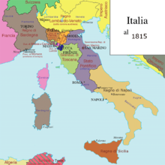
Restoration
When the Napoleonic system collapsed, the bourgeois hegemony over society does not could longer be less
The bourgeoisie was too strong awareness of the role it had played in the civil and in public life, in the name of economic primacy and intellectual capacity
The Italian sovereigns restored after the Congress of Vienna could not challenge the hegemony of the bourgeoisie

Slide 114
The administrative monarchy
The abolition of statutes of Napoleon brought about the birth of the idea of ​​administrative monarchy
It consisted of a system where efficiency and functionality were guaranteed by the technical collaboration between nobility and bourgeoisie, with the award of substantial conduct of public life to the sovereign
This led to the maintenance of the administrative or judicial institutions introduced by the French domination, but excluded those constitutional frames which would limit the absolute power of the sovereign, considered untouchable because it is based on divine right
In this way, however, the monarchies recognized the role of other members of society would have to play in the management of public affairs (the bourgeoisie and nobility)

Slide 115
Absurdity and illusions
The idea of the administrative monarchy in which political decisions were reserved for the Crown soon turned out to be illusory
It was absurd to conceive of an administration distinct from politics, because the activity of the state and its bodies had to be considered always of a political nature.
Even more illusory was to believe that the bourgeoisie called after 1815 to collaborate with the sovereigns, but subordinate to them, could accept to be excluded from the fundamental choices made by the power, after that in the French period it had been directly involved in the management of the power itself.

Slide 116
Revolution 1820-21
This explains the significance of the 1820-21 revolution and its constitutional choices
3 were the models to which the revolutionaries could be inspired, excluding the Napoleonic models:
  The democratic constitution of Cadiz of 1812, which guaranteed power to the bourgeoisie in a single chamber parliamentary system
  The aristocratic constitution of Palermo of 1812, well accepted by the feudal oligarchies
  The French constitution of 1814, which through the octroi (concession of the sovereign) made a compromise between the monarchy, the hereditary aristocracy and the rich land bourgeoisie

Slide 117
French Constitution in 1814
It was a constitution ‘ottriata’ (from the French octroyée: granted by the sovereign) by Louis XVIII, brother of the decapitated Louis XVI, just restored on the throne of France.
It was the result of a compromise between the "monarchical principle" and the "representative principle".
It foresaw the submission to the law of the monarch himself and restored the bicameralism with the Senate (House of Peers) of direct nomination and the House of Deputies elected by suffrage by census.
The French Constitutional Charter of 1814 inaugurated the season of "liberal conservative" constitutionalism and, together with the 1830 Charter, constituted the "limited monarchy" system that was a reference in 19th century continental Europe for those countries that wanted to equip themselves with written constitutions.

Slide 118
Plebs and bourgeoisie
The model chosen by the revolutionary groups in Sardinia and Sicily was that of the Constitution of Cadiz, mythicalized by the public for its national and popular content.
However, the bourgeois classes could not count on the support of the subordinate classes, who were in favour of monarchic conservation.
For these reasons, during the revolution the choice of the Spanish constitutional model in favour of the French one of 1814 was contested.
The latter was more acceptable to pro-monarchist and aristocratic circles as it guaranteed the Crown a greater role and protected noble positions.

Slide 119
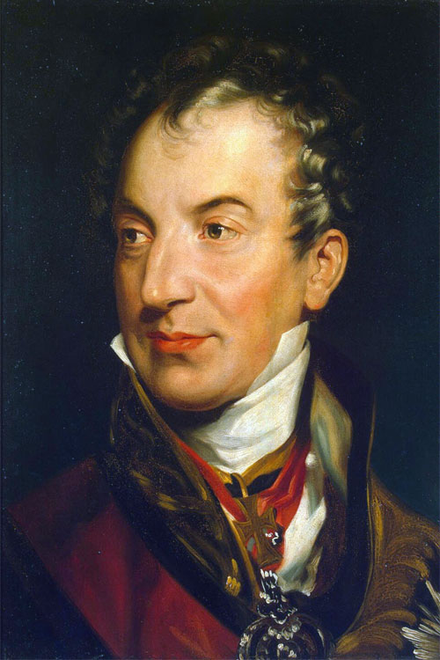
Advisory bodies
After the failure of the uprisings of 1820-21, however, this agreement between the liberal bourgeoisie and the monarchy was no longer feasible because of the distrust of all Italian sovereigns towards any constitutional project.
In these conditions it seemed necessary to establish simple consultative bodies, favoured by Klemens von Metternich after the Ljubljana conference, in an attempt to encourage bourgeois aspirations for greater participation of power (State Councils).

Slide 120
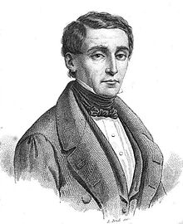
Looking for a constitution
The failure of the state councils marked the triumph of the statutory requirement that had been a dominant reason for liberal political thought in the early Nineteenth century
Italian publications (Pellegrino Rossi) took as a model the French constitution of 1830, overcoming that of 1814
In it, the King divided the legislative power between the two Chambers, but reserved for himself the executive power and the control over justice
The King's interference in the legislative power reflected the English approach of the King in Parliament, whereby the King is part of the Parliament.

Slide 121
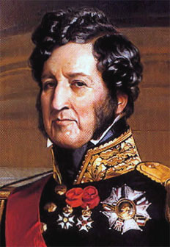
The French Constitution of 1830
The French constitution of 1830 was issued after the rise to power of Louis-Philippe
Unlike the 1814 Charter, it was no longer “ottriata", but established by mutual agreement between the sovereign and the Chamber of Deputies that had drawn it up.
The Constitution has the following innovations
  the King proclaims himself King of the French people, thus seeking to reconcile the principle of dynastic legitimacy with the principle of national sovereignity;
  The government's responsibility in front of Parliament, from which it had to gain trust if it wanted to remain in office;
  abolished the hereditary right of senators.

Slide 122
Primacy of the bourgeoisie
These factors made the 1830 Constitution more responsive to the bourgeois character imprinted by the July Revolution
The primacy of the bourgeoisie emerged from the representation in the two chambers and especially in the elective one
Very important appeared the unitary and homogeneous character of the government, responsible in front of Parliament, linked to it by a relationship of trust
The representative system and the primacy of parliament were validated by:
  The Belgian constitution of 1831 that sanctioned the elective nature of the Upper House (Senate) establishing a smaller electorate than the other Chamber
  The English electoral reform of 1832 (Reform Bill), which tripled the number of those entitled to vote, transformed the basis of the English constitution, making it from aristocratic to bourgeois.

Slide 123
From the Albertine Statute to the Constitution of the Italian Republic
1848-1948

Slide 124
1848 in Italy
In 1848 the constitutional authorities triumphed in the various Italian states
  They had a constitution granted by the King in the Kingdom of Sardinia, Grand Duchy of Tuscany, State of the Church and Duchy of Parma.
  In the kingdom of the two Sicilies, the constitution was the work of a parliament convened in Palermo, in contrast to the voluptuousness of the government of Naples.
  In the Roman Republic of 1849, the Charter was drawn up by a constituent assembly specifically elected for the purpose.
With the exception of these last two experiences, they were short constitutions, inspired by the French model of 1830:
  legislative power entrusted to the king and parliament
  Two chambers, one elected on a census basis and the other appointed by the King
  Judicial power dependent on executive power

Slide 125
The Albertine statute
The only constitution that survived the uprisings of 1848 was the Statute of the Kingdom of Sardinia
It became the fulcrum of liberal hopes in Italy
Thanks to its flexible constitution character (i.e. modifiable by ordinary law), it testified to its ability to conform to political transformations.
It consisted of 81 articles, 22 of which were reserved to define the prerogatives of the king, to whom was attributed the executive power, the nominal superintendence of the judiciary, the participation in the legislative power together with the Parliament.
The system of representation was bicameral:
  The Senate was composed of members appointed for life by the king;
  the Chamber of Deputies was accessed by representatives of the nation, voted on the basis of an electoral law that was not included in the Statute.
The fundamental rights of citizens and the inviolability of individual property were guaranteed.

Slide 126
Essential principles
The Albertine statute adapted it to the social and institutional changes that derived from the unification of Italy, from the extension of the right to vote, and from the passage in 1922 from the liberal state to the fascist one.
The essential principles of the Albertine Statute are:
  freedom of thought, speech and equality of citizens before the law;
  the executive power reserved exclusively for the king;
  the legislative power shared with the parliament;
  the judicial power entrusted to magistrates appointed by the royal court;
  the responsibility of ministers only before the king;
  the declaration of the Catholic religion as the "state religion".

Slide 127
Characters of the Albertine Statute
a constitution granted: the Statute was not the result of collaboration with the people;
a flexible constitution: the Statute could be modified by ordinary laws. Its elasticity allowed the transition to the fascist regime in a formally legal way;
a monarchic constitution: the structure of the State was of the monarchic type;
a representative constitution: the chamber of deputies was an elected assembly;
a confessional constitution: in the initial phase, the Statute provided for the Catholic religion as the only state religion.

Slide 128
Separation of powers
The form of government introduced by the Albertine Statute was not based on a clear separation of powers:
  the sovereign had executive power;
  the Parliament, composed of two chambers (Chamber of Deputies and Senate), shared with the king the ownership of the legislative power.
The two chambers were not placed on an equal footing:
  The Chamber of Deputies had greater powers;
  The judges were entrusted with the judicial power.

Slide 129
Italian Fascism
With the fascist laws of 1925, the Albertine Statute was considerably altered, to the point of making the very structure of the State authoritarian-totalitarian.
The change in the statute ended up giving the Prime Minister a leading legal position over the individual ministers.
This important institutional change was followed, in 1939, by the replacement of the Chamber of Deputies with the Chamber of Fasci.
In practice, the Chamber was made up partly of national councillors and partly of members of the Grand Council of Fascism.
Thus the Chamber, which had become a permanent assembly, was formed as a result of the appointment or removal from these offices, without having to resort to periodic electoral consultations for its renewal.

Slide 130
Totalitarian regime
The legislative reform determined the progressive establishment of a system of totalitarian government, based on the recognition of a single party, the fascist.
There constitutional crisis followed to the II world war which ravaged the country. The crisis opened on July 25, 1943 by Mussolini's dismissal as head of Government
It was launched to the king initiative and was supported by the Great Council, which relied on a provisional executive power to marshal Badoglio.
With the decree of August 2, 1943 the king established the dissolution of the Chamber of Fasci, speeding up the collapse of the fascist regime
After the armistice of September 8, 1943, Italy remained divided in two parts: the North, still in German hands with the fascist regime; the South, occupied by the Anglo-Americans, in which was restored the monarchical system.

Slide 131

Proclamation of the Italian Republic
In April 1944, an agreement was reached between the National Liberation Committees and King Vittorio Emanuele III, proclaiming the institutional truce, to heal this fracture.
Meanwhile, before the withdrawal of the German forces from Italy, on June 5, 1944, the king entrusted his son Umberto with the lieutenancy of the Kingdom, giving him the powers of head of state.
The general lieutenant accepted the principle that the people should be given the free choice about the institutional form of monarchy or republican, so on June 2, 1946 there was the referendum, which all the Italian population was convened for the choice between monarchy and republic.
In this way the Republic was proclaimed.

Slide 132


Birth of the Italian Republic

Slide 133
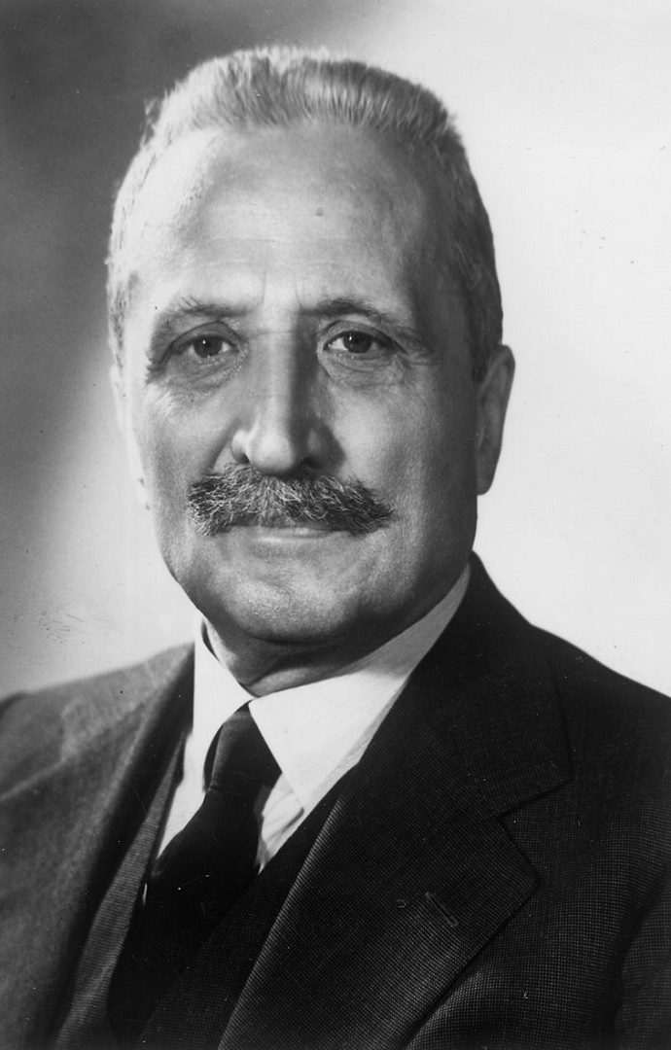
Constitution of 1948
After the referendum, on 25 June 1946, the Constituent Assembly, made up of 556 members, met to approve the new Republican Constitution.
It entrusted the drafting of the new Republican Constitution to a commission of 75 deputies, which concluded its work in plenary session on 22 December 1947 with the approval of the final text by secret ballot.
The promulgation by the provisional Head of State Enrico de Nicola, after five days, and the subsequent publication in the Official Gazette, allowed the entry into force of the new Constitution on 1 January 1948.

Slide 134
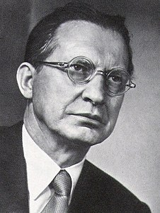
January 1, 1848
The Constitution is the State basic law.
Entry into force on 1 January 1948, he was signed by President of the Republic Enrico De Nicola and countersigned by the Prime Minister Alcide De Gasperi and the President of the Constituent Assembly Umberto Terracini.
There Constitution consists of 139 articles and 18 transitional and finals provisions:
  Basic principles (Art. 1-12).
  First Part (Art. 13-54) concerns the rights and duties of citizens.
  Second Part (Art. 55-139) is the largest part of the Constitution.
  In this section set out the powers, composition and appointment of the fundamental organs of the State.

Slide 135
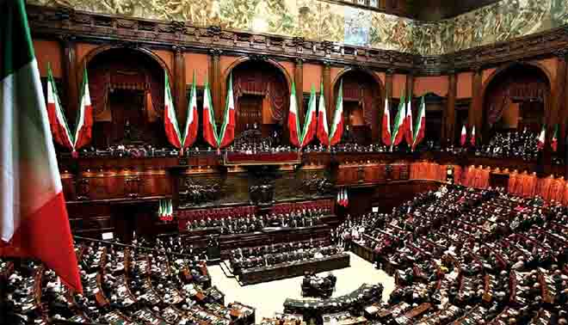
Constitutional bodies
The italian constitutional bodies are the Parliament; the President of the Republic; the Government; the Judiciary; the Constitutional Court.

Slide 136
Characters of the Italian Constitution (1)
a compromised constitution: the structure of the Constitutional Charter is based on the agreement between the various parties of the National Liberation Committee. The compromise reached allows for a balance, which gives due weight both to the need to recognise and guarantee freedoms and to the need to establish a welfare state;
a long constitution: the constitutional text sets out the fundamental lines of the state order, defines fundamental rights and organises the various aspects of society;
a voted constitution: the constitutional text is approved by a constituent assembly elected by the people;

Slide 137
Characters of the Italian Constitution (2)
a rigid constitution: unlike the albertine Statute, it can only be modified through a special procedure. This provides a guarantee that democratic freedoms will be maintained;
a secular constitution: all religious faiths, if in line with the italian legal system, have the same right to exist and operate on the national territory;
a pluralist constitution: the state recognizes and protects the different forms in which the multiple facets of society are expressed;
a liberal constitution; the principles of freedom are recognized and guaranteed by the law;
a social constitution: the State intervenes directly to ensure equality between citizens.

Slide 138
End of presentation
Thanks for your attention

